Slide 1

VISUAL FABRICATION
Project Presentation
Submitted To
Ms. Monika
(Assistant Professor)
Submitted By
Shristi Rai
Yash Mishra
Shubham Srivastava
Yash Jaiswal
Department of Computer Science & Engineering
IMS Engineering College, Ghaziabad, India
1
Notes:
1
1

Slide 2
Introduction

Slide 3
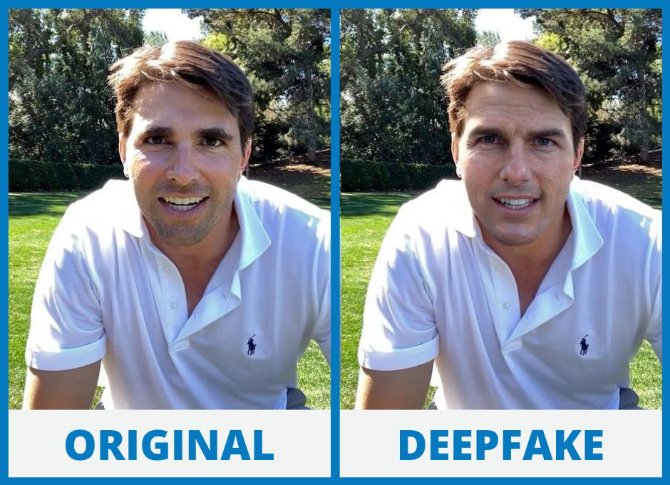

Slide 4
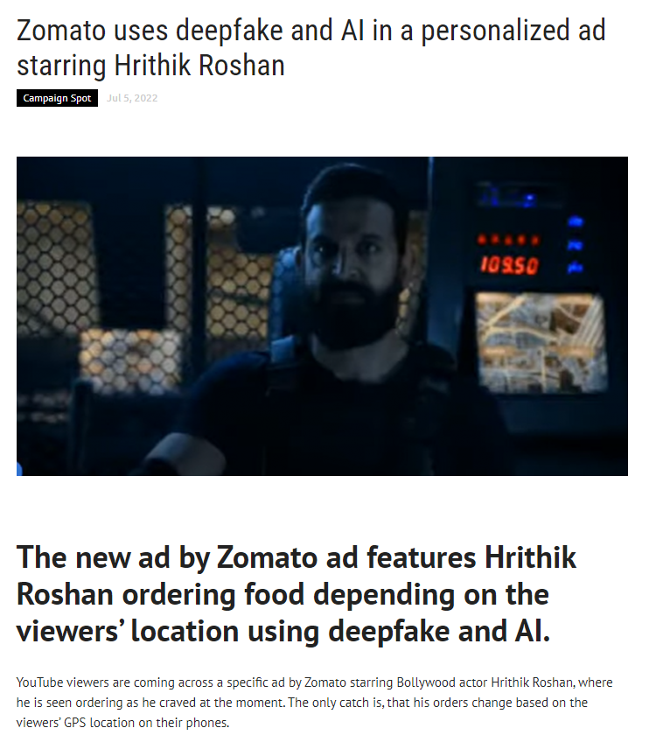






Slide 5
Brief Description About the Project

Slide 6
Visual Fabrication or Deepfakes are fake videos that look and sound just like the real thing.
Deepfakes use deep learning artificial intelligence to replace the likeness of one person with another in video and other digital media.
Deep learning algorithms, which teach themselves how to solve problems when given large sets of data, are used to swap faces in the video and digital content to make realistic-looking fake media.

Slide 7
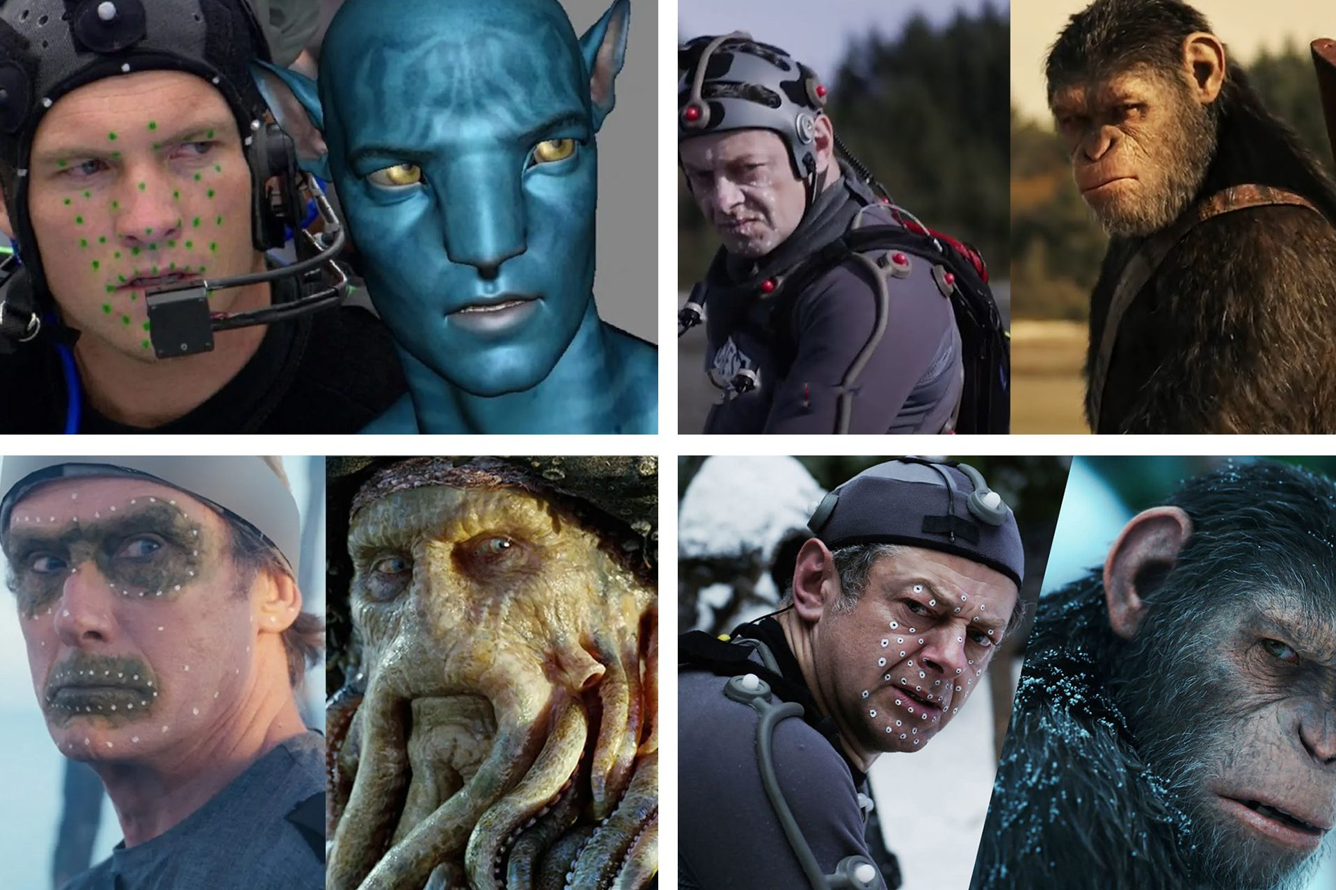
What is CGI?
Computer-generated imagery, or CGI for short, is a term that describes digitally-created images in film and television. CGI is a subcategory of visual effects (VFX), imagery filmmakers create or manipulate that does not exist in the physical environment being captured on film or video. CGI is instrumental in the making of movies and television shows and serves as the primary method for creating 3D-computer graphics for video games.

Slide 8
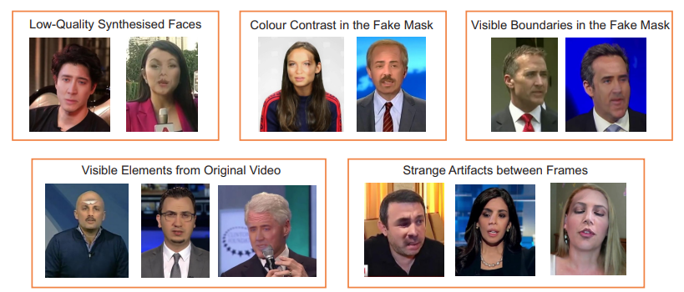
Why we are using CNN Algorithm in Deepfake creation?
Convolution Neural Networks (CNN) have been mentioned as one of the techniques for detecting Deepfake. When compared to other techniques for supervised learning in artificial intelligence, CNNs have demonstrated excellent capability and scalability for applications related image and video operations. A CNN is a particular type of network design for deep learning algorithms that is utilized for tasks like image recognition and pixel data processing.
Source : https://arxiv.org/pdf/1901.08971v3.pdf

Slide 9
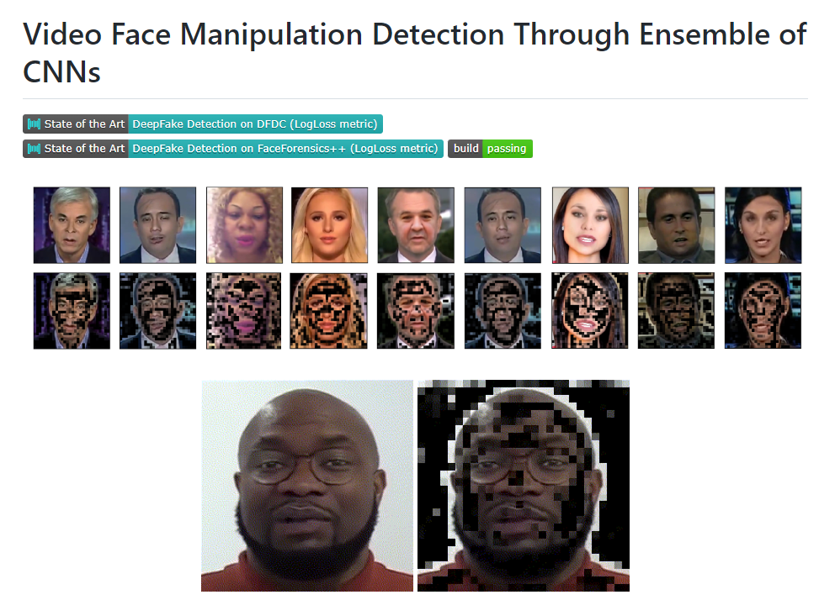



Slide 10
Conclusion

Slide 11
Synthetic data can generate value in many enterprise applications, across many industries.
Product development - Labs has used synthetic data to speed up product development while exploring more possible formulations than before.
Improving AI systems - Synthetic data is used to train machine learning systems when there isn’t enough real data available, or it isn’t practical to obtain.
Artistic enhancement - Deepfake technologies can support customized content for more inclusive communication and wider reach.
Maintaining privacy - Companies can use synthetic data sets for modelling and analysis without exposing real data.

Slide 12
References
https://www.researchgate.net/publication/336058980_Deep_Learning_for_Deepfakes_Creation_and_Detection_A_Survey
https://ieeexplore.ieee.org/document/9544522
https://www.sciencedirect.com/science/article/abs/pii/S1077314222001114
https://www.mdpi.com/2313-433X/9/1/18

Slide 13
Thank you
13
Notes:
13

